Slide 1
Lecture 4
I/O multiplexing and Socket options
Ren Liyong
电子科技大学信软学院

Slide 2

Contens
I/O Models
I/O multiplexing concept
Select and pselect functions
Socket options
Nonblocking IO
Signal-driven IO

Slide 3
I/O Models
Five I/O models under UNIX
  Blocking I/O
  Nonblocking I/O
  I/O multiplexing（select and poll）
  Signal driven I/O（SIGIO）and
  Asynchronous I/O（posix.1 aio_ funcitons)
There are two distinct phases for an input operation:
  Waiting for the data to be ready, and
  Copying the data from the kernel to the process

Slide 4
Blocking I/O Model
The most prevalent I/O model 。By default, all sockets are blocking
appliction
kernel
System call
recvfrom
No data ready
Wait for data
Process blocks in recvfrom
Data ready
Copy data
Copy data from kernel to user
System call
Process
data
Copy complete

Slide 5
Nonblocking I/O Model
When a socket is nonblocking, telling kernel: “ when an I/O operation that I request cannot be completed without putting the process th sleep, do not put the process to sleep”.
It is called polling, waste of CPU time.
Appliction
System call
Kernel
recvfrom
No data ready
EWOULDBLOCK
System call
Wait for data
recvfrom
No data ready
EWOULDBLOCK
Process blocks in recvfrom
System call
recvfrom
Data ready
Copy data
Copy data from kernel to user
System call
Process
data
Copy complete

Slide 6
I/O multiplexing Model
When I/O multiplexing, we call select or poll and block in one of these two system call, instead of blocking in the actual I/O system call.
application
kernel
System call
select
No data ready
Process blocks in select wait for one of possibly many sockets to become readable
Wait for data
Return readable
Data ready
Copy data
System call
recvfrom
Process blocks while data copied into application buffer
Copy data from kernel to user
System call
Process
data
Copy complete
Notes：in fact there is a slight disadvantage because using select require two system calls. But the advantage in using select is that we can wait for more than one descriptor to be ready.

Slide 7
Signal Driven I/O Model
Telling the kernel to notify us with the SIGIO signal when the descriptor is ready.
Advantage: process is not blocked while waiting for the datagram to arrive.
appliction
kernel
sigaction
Establish SIGIO handler
return
Process continues executing
Wait for data
deliver SIGIO
Signal handler
Data ready
Copy data
System call
recvfrom
Copy data from kernel to user
Process blocks while data copied into application buffer
Return OK
Copy complete
Process data

Slide 8
Asynchronous I/O Model
Asynchronous I/O tell the kernel to start the operation and to notify us when the entire operation is complete.
appliction
kernel
System call
aio_read
No data ready
return
Wait for data
Process continues executing
Data ready
Copy data
Copy data from kernel to user
Signal handler process dta
Deliver signal specified in aio_read
Copy complete
Main difference with signal-driven I/O:?
Notes:
这种模型与信号驱动模型的主要区别在于：信号驱动I/O由内河通知我们何时可以启动一个I/O操作，而异步I/O模型是由内核通知我们I/O操作何时完成。

Slide 9
Comparison of the I/O Model
blocks | Nonblock | I/O Multiplex | Signal-driven I/O | Asynchronous I/O
initate blocks complete | Check Check Check Check Check Check blocks complete | Check blocks ready blocks complete | notify blocked complete | initate complete
Wait for data
Copy data from kernel to user

Slide 10
同步i/o与异步i/o
Posix定义这两个术语如下：
  同步i/o操作引起请求进程阻塞，直到i/o操作完成；
  异步i/o操作不引起请求进程阻塞；
上述i/o模型中，前四个模型：阻塞i/o模型、非阻塞i/o模型、i/o复用模型和信号驱动模型都是同步i/o模型，因为真正的i/o操作（recvfrom）阻塞进程，只有异步i/o模型与此异步i/o定义相匹配。

Slide 11
I/O Multiplexing
What we need is the capability to tell the kernel that we want to be notified if one or more I/O conditions are ready (i.e., input is ready to be read, or the descriptor is capable of taking more output).
This capability is called I/O multiplexing and is provided by the select and poll functions.

Slide 12
Scenarios of I/O multiplexing
When a client is handling multiple descriptors (normally interactive input and a network socket).
If a TCP server handles both a listening socket and its connected sockets.
If a server handles both TCP and UDP.
If a server handlers multiple services and perhaps multiple protocols.
etc.

Slide 13
I/O复用的基本思想
先构造一张或多张包含所有需要等待的描述符的表，然后调用一个函数，它要到这些描述符中的一个或多个已准备好进行I/O时才返回。在返回时，它告诉进程哪一个描述符已准备好可以进行I/O。

Slide 14
Select Functions（1）
#include <sys/select.h>
#include <sys/time.h>
int select(int maxfd, fd_set *readset, fd_set *writeset, fd_set *exceptset, const struct timeval *timeout);
return: positive count of ready descriptors, o on timeout, -1 on error.
timeout tell kernel how long to wait
struct timeval {
long tv_sec; /* seconds */
long tv_usec; /* microseconds */
}
typedef struct {
__fd_mask fds_bits[__FD_SETSIZE / __NFDBITS];
} fd_set;

Slide 15
Select Functions（2）
Three possibilities:
  Wait forever：return only when one of the descriptors is ready for I/O. (timeout is specified as a NULL pointer)
  Wait up to a fixed amount of time：return when one of the descriptors is ready for I/O or timeout beyond.
  Do not wait at all: return immediately after checking the descriptors. To do this, timeout must be 0
The return value from select indicates the total number of bits that are ready.
In the first two scenarios is interrupted if the process catches a signal and return from handler.

Slide 16
Select Functions（3）
The three middle arguments readset ,writeset and execptset specify the descriptors set that we want the kernel to test for reading, writing, and exception conditions.
Select modifies the descriptor sets pointed to by the readset, writeset, and exceptset pointer. These three arguments are value-result argument. Any descriptor that is not ready on return will have its corresponding bit cleared in the set.

Slide 17
Select Functions（4）
Following four macros:
  Void FD_ZERO(fd_set *fdset); /* clear all bits in fdset */
  Void FD_SET(int fd, fd_set *fdset); /* turn on the bit for fd in fdset */
  Void FD_CLR(int fd, fd_set *fdset); /* turn off the bit for fd in fdset */
  Void FD_ISSET(int fd, fd_set *fdset); /* is the bit for fd on in fdset */
Note that:
  maxfd argument must be the maximum descriptor plus one.
  It is important to initialize the set, since unpredictable results can occur if the set is allocated as an automatic variable and not initialized.

Slide 18
Select Functions（5）
Conditions for socket ready for reading：
  The number of bytes of data in the socket receive buffer is greater than or equal to the current size of the low-water mark.
  The read-half of the connection is closed.
  The socket is a listening socket and the number of completed connections is nonzero.
  A socket error is pending.

Slide 19
Select Functions（6）
Conditions for socket ready for writing：
  The number of bytes of available space in the socket send buffer is greater than or equal to the current size of the low-water mark；
  The write-half of the connection is closed. A write operation one the socket will generate SIGPIPE.
  A socket error is pending.

Slide 20
EXP. :select（1）
#include <stdio.h>
#include <sys/time.h>
#include <sys/types.h>
#include <unistd.h>
int main(void) {
fd_set rfds;
struct timeval tv;
int retval;
/* Watch stdin (fd 0) to see when it has input. */
FD_ZERO(&rfds);
FD_SET(0, &rfds);
/* Wait up to five seconds. */
tv.tv_sec = 5;
tv.tv_usec = 0;

Slide 21
EXP. :select（2）
retval = select(1, &rfds, NULL, NULL, &tv);
/* Don't rely on the value of tv now! */
if (retval)
printf("Data is available now.\n");
/* FD_ISSET(0, &rfds) will be true. */
else
printf("No data within five seconds.\n");
exit(0);
}

Slide 22
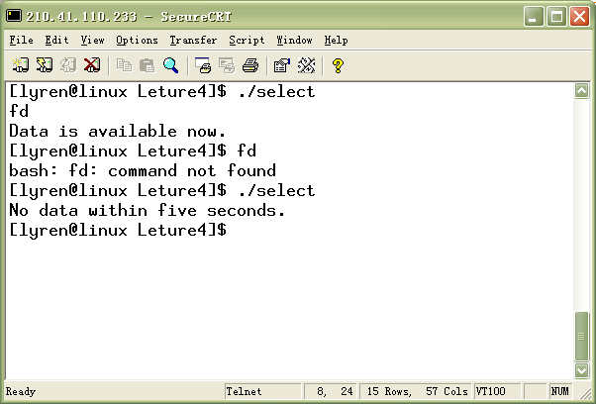
Result

Slide 23
Pselect Functions（1）
#include <sys/select.h>
#include <signal.h>
#include <sys/time.h>
int pselect (int maxfdp1, fd_set *readset, fd_set * writeset, fd_set * exceptset, const struct timespec * timeout, const sigset_t *sigmask);
return: count of ready descriptors, 0 on timeout, -1 on error。
pselect函数使用结构timespec，而不是timeval:
struct timespec {
time_t tv_sec; /* seconds */
long tv_nsec; /* nanoseconds */
}

Slide 24
Pselect Functions（2）
pselect adds a sixth argument: a pointer to a signal mask. This allows the program to disable the delivery of certain signals.

Slide 25
pselec函数例程
int main(void) {
fd_set rset;
sigset_t newsig,oldsig;
char temp[100];
FD_ZERO(&rset);
FD_SET(0,&rset);
sigemptyset(&newsig);
sigemptyset(&oldsig);
sigaddset(&newsig,SIGINT);
while(1) {
if(pselect(1,&rset,NULL,NULL,NULL,&newsig) > 0) {
fgets(temp,100,stdin);
printf("Input string is %s\n",temp);
exit(0);
}
}
}
等待rset中的描述字变为可读前，阻塞newsig中的信号。

Slide 26
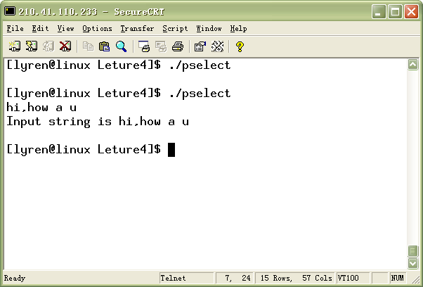
Pselect（）运行结果

Slide 27
Exp.: I/O Mulplexing
#include <stdio.h>
…
#define PORT 1234
#define BACKLOG 5
#define MAXDATASIZE 1000
tpedef struct CLIENT {
int fd;
char *name;
struct sockaddr_in addr;
char *data;
};
void process_cli(CLIENT *client, char *recvbuf, int len);
void savedata(char *recvbuf, int len, char *data);
int main(void) {
int i, maxi, maxfd, sockfd;
int nready;

Slide 28
Exp.: I/O Mulplexing （cont.）
ssize_t n;
fd_set rset, allset;
int listenfd, connectfd;
struct sockaddr_in server;
CLIENT client[FD_SETSIZE];
char recvbuf[MAXDATASIZE];
int sin_size;
/* Create TCP socket */ ……
/* Bind address */ ……
/* Listen socket listenfd */ ……
sin_size = sizeof(struct sockaddr_in);
maxfd = listenfd;
maxi = -1;

Slide 29

Exp.: I/O Mulplexing （cont.）
for (i =0; i< FD_SETSIZE; i++)
client[i].fd = -1;
FD_ZERO(&allset);
FD_SET(listenfd, &allset);
while (1) {
struct sockaddr_int addr;
rset = allset;
nready = select (maxfd+1, &rset, NULL, NULL, NULL);
if (FD_ISSET(lisetenfd, &rset)) {
if ((connectfd = accept(listenfd, (struct sockaddr &)&addr, &sin_size)) == -1) {
perror(“accept error.”);
continue;
}
此处应判断出错的情况（如信号中断）

Slide 30
Exp.: I/O Mulplexing （cont.）
for (i = 0; i < FD_SETSIZE; i++)
if (client[i].fd < 0) {
clinet[i].fd = connectfd;
client[i].name = new char[MAXDATASIZE];
client[i].addr = addr;
client[i].data = new char[MAXDATASIZE];
client[i].name[0] = ‘\0’;
client[i].data[0] = ‘\0’;
printf(“ You got a connect from %s. “, inet_ntoa(client[i].addr.sin_addr));
break;
}
if (i == FD_SETSIZE) printf(“too many cllients.\n”);
FD_SET(connectfd, &allset);

Slide 31
Exp.: I/O Mulplexing （cont.）
if (connectfd > maxfd) maxfd = connectfd;
if (i > maxi) maxi =i;
if ( -- nready < =0) continue;
} /* if (FD_ISSET (listenfd… */
for (i = 0; i <= maxi; i++) {
if ((sockfd = client[i].fd) < 0) continue;
if (FD_ISSET(sockfd, &rset)) {
if (( n = recv(sockfd, recvbuf, MAXDATASIZE, 0)) ==0) {
close(sockfd);
printf(“Client (%s) closed connection. User’s data: %s\n”, client[i].name, client[i].data);

Slide 32
Exp.: I/O Mulplexing （cont.）
FD_CLR(sockfd, &allset);
client[i].fd = -1;
delete client[i].name;
delete client[i].data;
} else
process_cli(&client[i], recvbuf, n);
if ( --nready <=0 ) break;
} /* if (FD_ISSET(sockfd, &rset)) */
} /* for(i = 0; i <= maxi; i++) */
} /* while(1); */
close(listenfd);
}

Slide 33
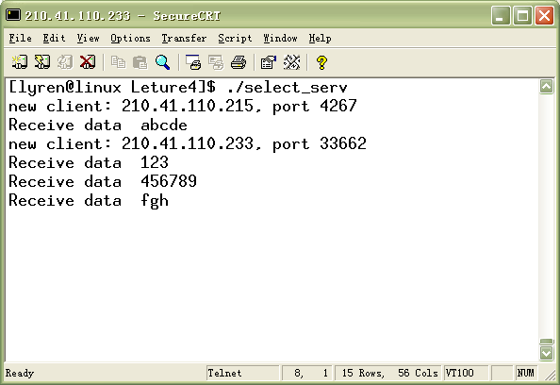
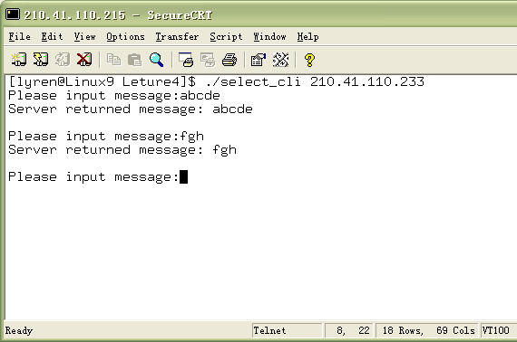
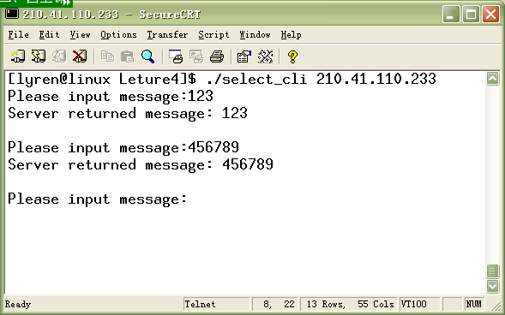

Slide 34
第四次作业
服务器利用I/O复用技术，实现同时向多个客户提供服务。要求：
服务器：接收客户连接请求，并打印客户IP地址及端口号，然后接收客户发来的字符串，并打印该字符串和其来自与哪个客户。同时向客户返回该字符串。当某一客户断开连接时，要求服务器打印该客户输入的所有字符。
客户：从命令行接收服务器地址，并向服务器发起连接请求，连接成功后，从标准输入接收字符串并发送给服务器，等待服务器响应并打印接收的信息。

Slide 35
Socket Options
There are various ways to get and set the options that affect a socket.
  The getsockopt and setsockopt functions
  The fcntl function
  The ioctl funciton

Slide 36
Getsockopt and setsockopt Functions
#include <sys/socktet.h>
int getsockopt(int sockfd, int level, int optname, void *optval, socklen_t *optlen);
int setsockopt(int sockfd, int level, int optname, const void *optval, socklen_t *optlen);
Return：0 on OK；-1 on error。
sockfd must refer to an open socket descriptor. The level specifies the code in the system to interpret the option.
optval is a pointer to a variable from which the new value of the option is fetched by setsockopt, or into which the current value of the option is store by getsockopt.

Slide 37
Parts of socket options
套接字的选项有很多，读者可参考《unix network programming》p.179。常见的有：
  Level optnanme datatype description
SOL_SOCKET
SO_DONTROUTE int bypass routing table lookup
SO_KEEPALIVE int periodically test if connection still alive
SO_RCVBUF int receive buffer size
SO_SNDBUF int send buffer size
SO_REUSEADDR int allow local address reuse
SO_REUSEPORT int allow local port reuse
IPPROTO_TCP TCP_MAXRT int TCP maximum retransmit time
TCP_MAXSEG int TCP maximum segment size
如：
int opt = SO_REUSEADDR;
setsockopt(listenfd, SOL_SOCKET, SO_REUSERADDR, &opt, sizeof(opt));

Slide 38
SO_KEEPALIVE socket option
This option can be use to detect whether peer host still alive. Default, if no data has been exchanged across the socket in either direction for 2 hours, TCP automatically sends a keepalive probe to the peer. This is probe is a TCP segment to which the peer must respond. One of three scenarios results:
  The peer responds with the expected ACK.
  The peer respond with an RST, which tells the local TCP that peer has crashed and rebooted.
  There is no respond from the peer. TCP will send eight additional probes, 75 seconds apart.

Slide 39
SO_KEEPALIVE socket option
User can modify the timing parameters (proc/sys/net/ipv4/) 。But be aware that most kernels maintain these parameter on a per-kernel basis , not on a per-socket basis.
This option is normally used by servers. Servers use the option because they need know whether those no data changing clients still alive.
Most Rlogin and Telnet server set this option to terminate the connection if the interactive client hangs up the phone line or powers off.

Slide 40
Ways to detect various TCP conditions
情形 | 对方进程崩溃 | 对方主机崩溃 | 对方主机不可达
本地tcp正主动发送数据 | 对方tcp发送一个FIN,我们它通过使用select可立即检测出来。如果本地tcp发送另外一个分节，对方tcp以RST响应。如果再发送另外一个分节，本地tcp就给我们一个SIGPIPE信号 | 本地tcp将超时，且套接字的待处理错误被设置为ETIMEDOUT | 本地tcp将超时，且套接字的待处理错误被设置为EHOSTUNRACH
本地tcp正主动接收数据 | 对方tcp发送一个FIN，我们将把它作为一个（可能是过早的）文件结束符读入 | 我们将停止接收数据 | 我们将停止接收数据
连接空闲，保持存活选项已设置 | 对方tcp发送一个FIN，我们通过使用select判断可读条件立即能检测出来 | 在毫无动静2小时后，发送9个存活探测分节，然后套接字的待处理错误被设置为etimedout | 在毫无动静2小时后，发送9个存活探测分节，然后套接字的待处理错误被设置为ehostunreach
连接空闲，保持存活选项未设置 | 对方tcp发送一个FIN，我们通过使用select判判断可读条件立即能检测出来 | （无） | （无）

Slide 41
SO_LINGER Socket option
By default, close returns immediately, but if there is any data still remaining in the send buffer, the system will try deliver the data to the peer.
The SO_LINGER（level: SOL_SOCKET）socket option lets us change this default.
Following structure must be passed between the user process and the kernle
#include <sys/socket.h>
struct linger {
int l_onoff; /* 0 = off, nonzero = on */
int l_linger; /* linger time, posix.1g specifies units as seconds */
}

Slide 42
SO_LINGER Socket option
If l_onff is 0，the option is turned off, the value of l_linger is ignored。
If l_onff is nonzero and l_linger is 0. TCP aborts the connection when it is closed. TCP discards any data still remaining in the send buffer and sends an RST to the peer.
If l_onoff is nonzero，and l_linger is nonzero, then the kernel will linger when the socket is closed. That is, if there is any data still remaining in the send buffer, the process is put to sleep until either (a) all the data is send and acknowledged bye the peer TCP, or (b) the linger time expires (close will return EWOULDBLOCK error).

Slide 43
SO_LINGER Socket option
Note that: successful return from close ,with SO_LINGER socket option set, only tell us that the data we sent (and our FIN) have been acknowledged by peer TCP. This does not tell us whether the peer application has read the data. Otherwise if SO_LINGER is not set, we do not know whether the peer TCP has ACK the data.
One way for the client to know that server has read its data is to call shutdown instead of close and wait for the peer to close its end of connection.

Slide 44
SO_LINGER Socket option
client
server
Client
Server
write
data
write
data
close
return
FIN
Data queued
by TCP
close
Data queued
by TCP
FIN
ACK of data and FIN
ACKof data and FIN
FIN
close
close返回
FIN
close
ACK of data and FIN
ACK of data and FIN
close的缺省操作
设置SO_LINGER,且l_linger为正值时的close

Slide 45
shutdown和应用ACK
Client
Server
Client
Server
write
Read block
write
data
data
Data queued
by TCP
Data queued
by TCP
shutdown
Read block
FIN
Application reads
queued data and FIN
ACK of data
应用进程读排队
ACK of data and FIN
1 byte data（应用ACK）
FIN
close
Read return 1
Close return
Read
return 0
FIN, ack of 1 byte data
ACK of data and FIN
Ack of FIN
close
FIN
Ack of FIN
用shutdown来获知对方已接收数据
应用ACK

Slide 46
函数 | 说明
Shutdown, SHUT_RD | 在套接口上不能再发出接收请求，进程仍然可往套接口上发送；套接口接收缓冲区中所有数据被丢弃；再接收的任何数据都由tcp丢弃；对套接口发送缓冲区无任何影响；
Shutdown, SHUT_WR | 在套接口上不能再发出发送请求；进程仍然可从套接口接收；套接口发送缓冲区中内容被发往另一端，后跟正常的tcp连接终止序列（FIN），对套接口接收缓冲区无任何影响；
close, l_onoff = 0 缺省情况 | 在套接口上不能发出发送或接收请求；套接口发送缓冲区中的内容被发往另一端，如果描述字访问计数变为0，在发完数据后发出正常的tcp终止序列，接收缓冲区内容被丢弃；
close, l_onoff = 1 l_linger = 0 | 不能再发出发送或接收请求；如果描述字访问计数变为0：RST被发往另一端，连接状态被置为CLOSED（无TIME_WAIT状态）。缓冲区数据被丢弃；
close, l_onoff = 1 l_linger != 0 | 在套接口上不能再发出发送或接收请求；套接口发送缓冲区中的数据被发往另一端。如果描述字访问计数变为0：在发完发送缓冲区中的数据后，发出正常的tcp连接终止序列（FIN），接收缓冲区中的数据被丢弃，如果在连接变为CLOSED前延滞时间到，则close返回EWOULDBLOCK错误。
Shutdown和close(SO—LINGER选项)各种情况的总结

Slide 47
SO_RCVBUF and SO_SNDBUF Socket Option
Every socket has a send buffer and a receive buffer. The receiver buffers are used by TCP and UDP to hold received data until it is read by the application. The TCP socket receive buffer cannot overflow.
We can modify the default buffer size through these tow socket option. When setting the size of the TCP socket receive buffer, the ordering of the function calls is important. This is because of TCP’s window scale option, which is exchanged with the peer one the SYN when the connection is established.

Slide 48
SO_RCVLOWAT and SO_SNDLOWAT Socket Options
Every socket also has a receive low-water mark and a send low-water mark. These are used by the select function.
The receive low-water mark is the amount of data that must be in the socket receive buffer for select to return “readable”. It defaults to 1 for a TCP or UDP socket.
The send low-water mark is the amount of available space that must exist in the socket send buffer for select return “writable”. Since the number of bytes of available space in the send buffer for a UDP socket never changes, as long as the UDP socket send buffer size is greater than the low-water mark, the UDP socket is always writable.

Slide 49
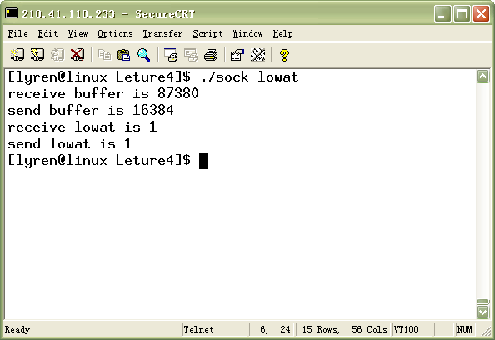
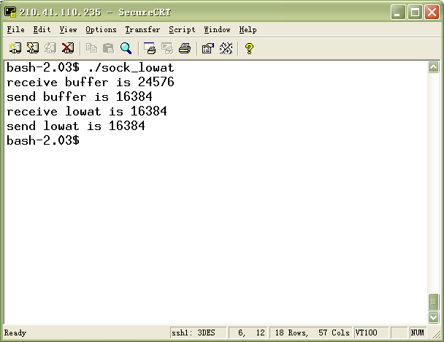
Linux系统
Solaris系统

Slide 50
SO_RCVTIMEO vs. SO_SNDTIMEO Socket options
These two socket options allow us to place a timeout on socket receives and sends. Both timeouts are disabled by default.
The receive timeout affects the five functions: read、readv、recv、recvfrom和recvmsg、accept；the send timeout affects the five functions: write、writev、send、sendto and sendmsg。
例外的情况是：如果套接字设置为非阻塞模式，所有的读写操作将直接返回，而不论缓冲区是否有数据（或有空间）。

Slide 51
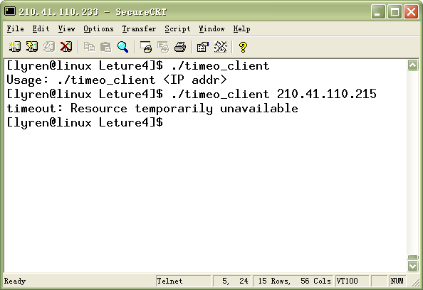
接收数据超时例子

Slide 52
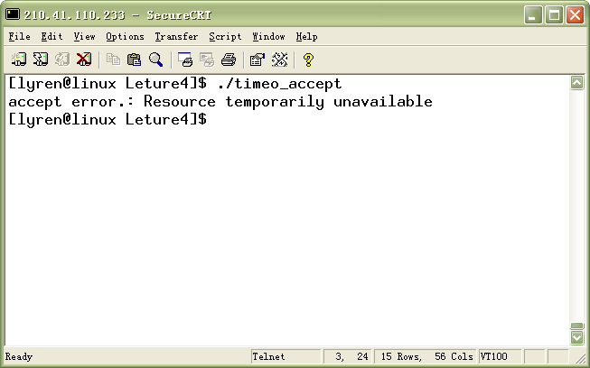
接收连接超时例子

Slide 53
SO_REUSEADDR Socket Option
SO_REUSEADDR allow a listening server to start and bind its well-known port even if previously established connections exist that use this port as their local port.
SO_REUSEADDR allows multiple instances of the same server to be started on the same port, as long as each instance binds a different local IP address. With TCP we are never able to start multiple servers that bind the same IP and the same port: a completely duplicate binding.
SO_REUSEADDR allow a single process to bind the same port to multiple sockets, as long as each bind a different IP address.

Slide 54
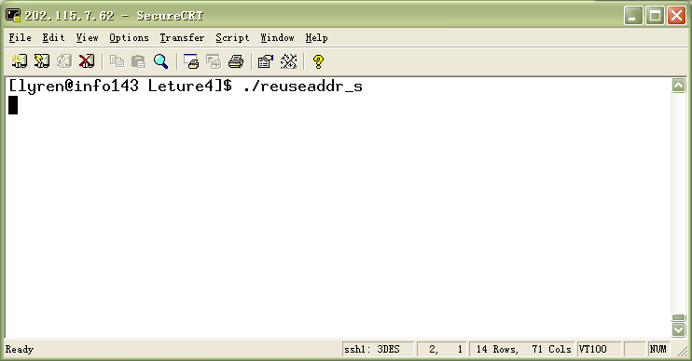
Exp. SO_REUSEADDR
此处有个例子程序

Slide 55
SO_ERROR选项
当套接口上发生错误时，BSD的内核中协议模块将此套接口的名为so_error的变量设置为标准的Unix Exxx错误，称为此套接口的待处理错误。内核可立即以下面的两种方式通知进程：
  如果进程阻塞于对此套接口的select，则无论是检查可读条件还是可写条件，select均返回并设置其中的一个或两个条件；
  如果进程使用信号驱动模型，则给进程或进程组生成信号SIGIO。
进程可以通过getsockopt函数和SO_ERROR选项来获取该套接口的待处理错误。so_error随后由内核复位为0；

Slide 56
IPv4 option：IP_HDRINCL
If this option is set for a raw socket, we must build our own IP header for all the datagrams that we send on the raw socket.
Normally the kernel builds the IP header for datagrams sent on a raw socket.

Slide 57
测试本机支持的选项
#include <netinet/tcp.h> /* for TCP_xxx defines */
union val {
int i_val;
long l_val;
char c_val[10];
struct linger linger_val;
struct timeval timeval_val;
} val;
static char *sock_str_flag(union val *, int);
static char *sock_str_int(union val *, int);
static char *sock_str_linger(union val *, int);
static char *sock_str_timeval(union val *, int);

Slide 58
测试本机支持的选项（续）
struct sock_opts {
char *opt_str;
int opt_level;
int opt_name;
char *(*opt_val_str)(union val *, int);
} sock_opts[] = {
"SO_BROADCAST", SOL_SOCKET, SO_BROADCAST, sock_str_flag,
"SO_DEBUG", SOL_SOCKET, SO_DEBUG, sock_str_flag,
"SO_DONTROUTE", SOL_SOCKET, SO_DONTROUTE, sock_str_flag,
"SO_ERROR", SOL_SOCKET, SO_ERROR, sock_str_int,
"SO_KEEPALIVE", SOL_SOCKET, SO_KEEPALIVE, sock_str_flag,
"SO_LINGER", SOL_SOCKET, SO_LINGER, sock_str_linger,
"SO_OOBINLINE", SOL_SOCKET, SO_OOBINLINE, sock_str_flag,
"SO_RCVBUF", SOL_SOCKET, SO_RCVBUF, sock_str_int,

Slide 59
测试本机支持的选项（续）
"SO_SNDBUF", SOL_SOCKET, SO_SNDBUF, sock_str_int,
"SO_RCVLOWAT", SOL_SOCKET, SO_RCVLOWAT, sock_str_int,
"SO_SNDLOWAT", SOL_SOCKET, SO_SNDLOWAT, sock_str_int,
"SO_RCVTIMEO", SOL_SOCKET, SO_RCVTIMEO, sock_str_timeval,
"SO_SNDTIMEO", SOL_SOCKET, SO_SNDTIMEO,sock_str_timeval,
“SO_REUSEADDR”, SOL_SOCKET, SO_REUSEADDR, sock_str_flag,
#ifdef SO_REUSEPORT
"SO_REUSEPORT", SOL_SOCKET, SO_REUSEPORT, sock_str_flag,
#else
"SO_REUSEPORT", 0, 0, NULL,
#endif

Slide 60
测试本机支持的选项（续）
"SO_TYPE", SOL_SOCKET, SO_TYPE, sock_str_int,
"SO_USELOOPBACK",SOL_SOCKET, SO_USELOOPBACK, sock_str_flag,
"IP_TOS", IPPROTO_IP, IP_TOS, sock_str_int,
"IP_TTL", IPPROTO_IP, IP_TTL, sock_str_int,
"TCP_MAXSEG", IPPROTO_TCP,TCP_MAXSEG, sock_str_int,
“TCP_NODELAY”, IPPROTO_TCP,TCP_NODELAY, sock_str_flag,
NULL, 0, 0, NULL
};

Slide 61
测试本机支持的选项（续）
int main(int argc, char **argv) {
int fd, len;
struct sock_opts *ptr;
fd = Socket(AF_INET, SOCK_STREAM, 0);
for (ptr = sock_opts; ptr->opt_str != NULL; ptr++) {
printf("%s: ", ptr->opt_str);
if (ptr->opt_val_str == NULL)
printf("(undefined)\n");
else {
len = sizeof(val);
if (getsockopt(fd, ptr->opt_level, ptr->opt_name,
&val, &len) == -1) {
err_ret("getsockopt error");

Slide 62
测试本机支持的选项（续）
} else {
printf("default = %s\n", (*ptr->opt_val_str)(&val, len));
}
}
}
exit(0);
}

Slide 63
测试本机支持的选项（续）
static char strres[128];
static char *sock_str_flag(union val *ptr, int len)
{
/* *INDENT-OFF* */
if (len != sizeof(int))
snprintf(strres, sizeof(strres), "size (%d) not sizeof(int)", len);
else
snprintf(strres, sizeof(strres),
"%s", (ptr->i_val == 0) ? "off" : "on");
return(strres);
/* *INDENT-ON* */
}

Slide 64
测试本机支持的选项（续）
static char *sock_str_int(union val *ptr, int len)
{
if (len != sizeof(int))
snprintf(strres, sizeof(strres), "size (%d) not sizeof(int)", len);
else
snprintf(strres, sizeof(strres), "%d", ptr->i_val);
return(strres);
}

Slide 65
测试本机支持的选项（续）
static char *sock_str_linger(union val *ptr, int len)
{
struct linger *lptr = &ptr->linger_val;
if (len != sizeof(struct linger))
snprintf(strres, sizeof(strres),
"size (%d) not sizeof(struct linger)", len);
else
snprintf(strres, sizeof(strres), "l_onoff = %d, l_linger = %d",
lptr->l_onoff, lptr->l_linger);
return(strres);
}

Slide 66
测试本机支持的选项（续）
static char *sock_str_timeval(union val *ptr, int len)
{
struct timeval *tvptr = &ptr->timeval_val;
if (len != sizeof(struct timeval))
snprintf(strres, sizeof(strres),
"size (%d) not sizeof(struct timeval)", len);
else
snprintf(strres, sizeof(strres), "%d sec, %d usec",
tvptr->tv_sec, tvptr->tv_usec);
return(strres);
}

Slide 67
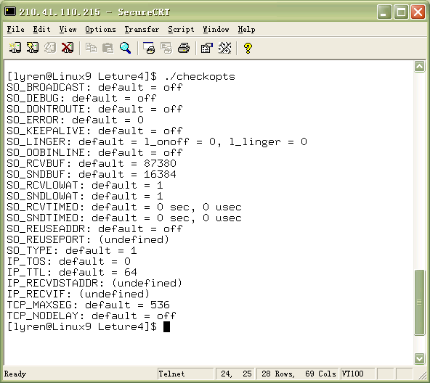
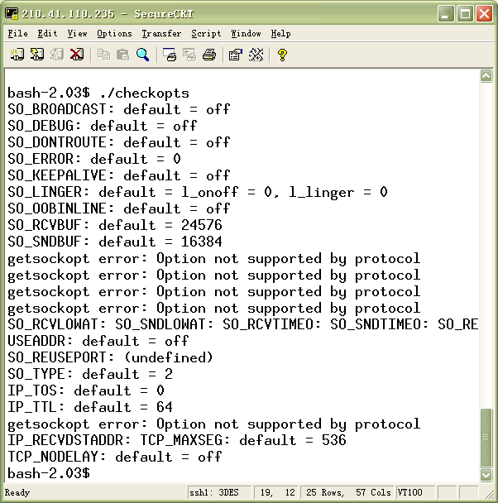
Linux
系统
Solaris
系统

Slide 68
Fcntl Function
#include <fcntl.h>
int fcntl(int fd, int cmd, … /* int arg */);
Return: depends on cmd if OK, -1 on error。
Each descriptor (including a socket ) has a set of file flags that are fetched with the F_GETFL command and set with the F_SETFL command.

Slide 69
Fcntl Function （cont.）
The two flags that affect a socket are：
  O_NONBLOCK nonblocking I/O
  O_ASYNC signal-driven I/O notification
Typical code to enable nonblocking I/O:
  int flags;
  if ((flags = fcntl(fd, F_GETFL, 0)) < 0)
  err_sys(“…”);
  flags |= O_NONBLOCK;
  if ((flags = fcntl(fd, F_SETFL, flags)) < 0)
  err_sys(“…”);
Turn off the nonblocking flag:
  flags &= ~O_NONBLOCK;
  if (fcntl(fd, F_SETFL, flags) < 0)
  err_sys(“…”);
必须和原有的标志“或”。

Slide 70
Fcntl Function （cont.）
  F_SETOWN command let us set the owner of the socket (process ID or process group ID)，which will receive the signal SIGIO and SIGURG。 These tow signals generated for a socket only if the socket has been assigned an owner with F_SETOWN command.
  F_GETOWN command return the owner of the socket

Slide 71
ioctl函数
传统上的ioctl函数是用于那些普遍使用，但不适合归入其他类别的任何特殊的相同接口，如终端、打印机；
网络程序中的ioctl常用于在程序启动时获得主机上所有接口的信息：接口的地址、接口是否支持广播、是否支持多播，也可以对套接字进行控制，如设置套接字的属主、是否是非阻塞的等等。

Slide 72
Ioctl Function
#include <unistd.h>
int ioctl(int fd, request, … /* void *arg */);
Return: 0 on OK, -1 on error.
Category Request Description Datatype
socket SIOCSPGRP set process ID or group ID of socket int
file FIONBIO set/clear nonblocking flag int
FIOASYNC set/clear asynchronous I/O flag int
FIOREAD get # bytes in receive buffer int
interface SIOCGIFCONF get list of all interface struct ifconf
SIOCSIFADDR set interface address struct ifreq
SIOCGIFADDR get interface address struct ifreq
Etc. see p427

Slide 73
fcntl与ioctl操作小结
操作 | fcntl | ioctl | Posix.1g
设置套接字为非阻塞i/o型 | F_SETFL, O_NONBLOCK | FIONBIO | fcntl
设置套接字为信号驱动i/o型 | F_SETFL, O_ASYNC | FIOASYNC | fcntl
设置套接字属主 | F_SETOWN | SIOCSPGRP或FIOSETOWN | fcntl
获取套接字属主 | F_GETOWN | SIOGPGRP或FIOGETOWN | fcntl
获取套接字接收缓冲区中的字节数 |  | FIONREAD
测试套接字是否在带外数据标志 |  | SIOCATMARK | sockatmark

Slide 74
Nonblocking I/O
By default, sockets are blocking. We can divide the socket call that may block into four categories:
  Input operations：read, readv, recv, recvfrom and recvmsg. If there is no data available in the receive buffer, process are put to sleep until some data arrive.（在没有设置接收超时的前提下）。（if the input operation cannot be satisfied, return is made immediately with an error EWOULDBLOCK）。

Slide 75
非阻塞I/O（cont.）
  Output operations: write, writev, send, sendto and sendmsg。For TCP, if there is no room in the socket send buffer for a blocking socket, the process will sleep until room is available.（not set timeout）. On the other hand，for nonblocking socket, error EWOULDBLOCK will return immediately. Because no actual UDP send buffer, an output operation on a blocking UDP socket should never block.
  Accepting incoming connections: accept. If a new connection is not available, accept on blocking socket will result process sleep.(not set timeout)。If on nonblocking socket, would return error EWOULDBLOCK.

Slide 76
非阻塞I/O（cont.）
  Initiating outgoing connection: connect. For TCP connection, the connect does not return until a RTT complete. If connect is called for a nonblocking TCP socket and the connection cannot be established immediately, the error EINPROGRESS is returned, but the connection establishment is initiated.

Slide 77
Nonblocking connect
Three uses for a nonblocking connect：
  We can overlap other processing with the three-way handshake. A connect take at least one RTT to complete.
  We can establish multiple connections at the same time using this technique. (Web browser)
  We can specify a time limit for select, allowing us to shorten the timeout for the connect (75s,default).

Slide 78
Nonblocking connect (Con.)
There are Details that we must handle
  Even though the socket is nonblocking , if the server to which we are connecting is on the same host, the connection take place immediately when we call connect.
  Berkeley-derived have the following two rules regarding select and nonblocking connect (1) when connection completes successfully, the descriptor becomes writable.(2) when the connection established encounters an error,the descriptor becomes both readable and writable.

Slide 79
非阻塞connect的一种实现
int connect_nonb(int sockfd, const SA *saptr, socklen_t salen, int nsec)
{
int flags, n, error;
socklen_t len;
fd_set rset, wset;
struct timeval tval;
flags = Fcntl(sockfd, F_GETFL, 0);
Fcntl(sockfd, F_SETFL, flags | O_NONBLOCK);
error = 0;
if ( (n = connect(sockfd, (struct sockaddr *) saptr, salen)) < 0)
if (errno != EINPROGRESS)
return(-1);
发生了其他类型的错误

Slide 80
非阻塞connect的一种实现（续）
if (n == 0)
goto done; /* connect completed immediately */
/* Do whatever we want while the connect is taking place. */
FD_ZERO(&rset);
FD_SET(sockfd, &rset);
wset = rset;
tval.tv_sec = nsec;
tval.tv_usec = 0;
if ( (n = Select(sockfd+1, &rset, &wset, NULL,
nsec ? &tval : NULL)) == 0) {
close(sockfd); /* timeout */
errno = ETIMEDOUT;
return(-1);
}

Slide 81
非阻塞connect的一种实现（续）
if (FD_ISSET(sockfd, &rset) || FD_ISSET(sockfd, &wset)) {
len = sizeof(error);
if (getsockopt(sockfd, SOL_SOCKET, SO_ERROR, &error, &len) < 0)
return(-1); /* Solaris pending error */
} else
err_quit("select error: sockfd not set");
done:
Fcntl(sockfd, F_SETFL, flags); /* restore file status flags */
if (error) {
close(sockfd); /* just in case */
errno = error;
return(-1);
}
return(0);
}
此处存在一个移植性问题，发生错误时，BSD返回0，而Sollaris返回－1。

Slide 82
非阻塞connect的一种实现（续）
实际上，还可以采用其他方法代替getsockopt来判断连接是否成功建立：
  调用getpeername来代替getsockopt，如果这个调用失败，返回ENOTCONN,表示连接失败。
  调用read，长度参数为0，如果read失败，则表示connect失败，而且read返回的errno指明了连接失败的原因。
  再次调用connect一次，他应该失败。
  ……

Slide 83
非阻塞I/O（总结）
select和非阻塞i/o一起使用可以判断描述字何时可以读或写。尽管非阻塞i/o在执行速度上非常快，但由此带来的编程复杂性却很大，如果对程序的响应速度要求不是很高，或最终的服务器程序负载不会很大，一般不建议使用非阻塞i/o。
实际上，在某些场合下可以用多进程或多线程实现非阻塞i/o实现的功能。

Slide 84
Signal-driven I/O Model
Signal-driven I/O is when we tell the kernel to notify us with a signal when something happens on a descriptor.
To use signal-driven I/O with a socket (SIGIO) requires perform the following three steps:
  A signal handler must be established for SIGIO
  The socket owner must be set (F_SETOWN)
  Signal-driven I/O must be enable (F_SETFL command and O_ASYNC flag)
顺序非常重要

Slide 85
SIGIO with UDP Sockets
Using signal-driven I/O with UDP is simple. The signal is generated whenever:
  A datagram arrives for the socket, or
  An asynchronous error occurs on the socket（只有当udp套接字已连接时才会产生这种错误）。

Slide 86
SIGIO with TCP Sockets
Signal-driven I/O is to useless with a TCP socket. The problem is that the signal is generated too often, and the occurrence of the signal does not tell us what happen.
  A connection request has complete on a listen socket
  A disconnect request has been initated
  A disconnect request has complete
  Half of a connection has been shut down
  Data has arrive on a socket
  Data has been sent from a socket
  An asynchronous error occurred.

Slide 87
处理被中断的系统调用
对于慢系统调用，有可能被信号中断。有些内核自动重启某些被中断的系统调用(如4.4BSD），而有些则不支持（如solaris2.5）。为了实现自动重启某些被中断的系统调用，可以如下：
for( ; ; ) {
clilen = sizeof(cliaddr);
if ((connfd = accept(listenfd, (SA *)&cliaddr,&clilen) < 0 ) {
if (errno == EINTR)
continue;
else
err_sys(“accept error”);
}
}
有一个函数不能自动重启：connect，否则立即返回错误（在BSD和SVR4中）,对于这个函数可以调用select来等待连接。在Linux中则可以重启。

Slide 88
手动重启connect
void fun(int);
int main(void)
{
struct sockaddr_in server;
int sockfd;
struct sigaction act;
act.sa_handler = fun;
act.sa_flags = 0;
socket(……);
sigaction(SIGINT, &act, NULL);
……
while(1)
{
if (connect(sockfd, (struct sockaddr *)&server,sizeof(server)) == -1)

Slide 89
手动重启connect
if (errno == EINTR) {
printf("interupted , and restart.\n");
continue;
}
else
break;
}
else {
printf("connect sucessed.\n");
break;
}
}
}
void fun(int sig)
{
printf("in signal function.\n");
}

Slide 90
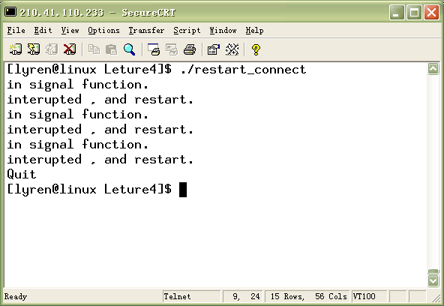
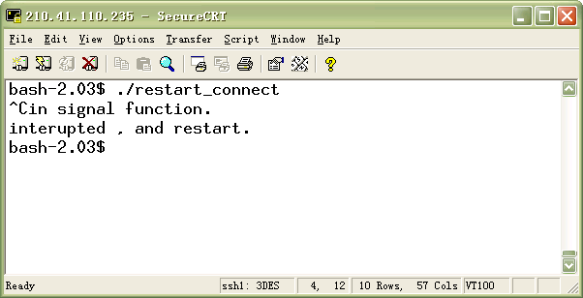
手动重启connect
Linux系统允许重启connect
Solaris系统不允许重启connect

Slide 91
第五次作业
建立自动重启被信号中断的系统调用connect的程序。

